Slide 1


Slide 2

FIRST
For The Inspiration and Recognition of Science and Technology
Founded in 1989 by Dean Kamen and Woody Flowers
"To transform our culture by creating a world where science and technology are celebrated and where young people dream of becoming science and technology leaders."
Dean Kamen, Founder
Junior Lego League, Lego League, Tech Challenge, Robotics Competition

Slide 3
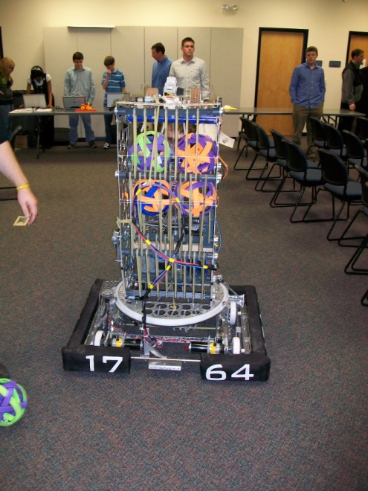
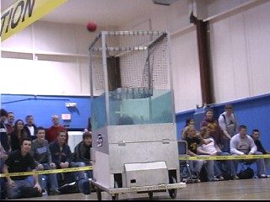
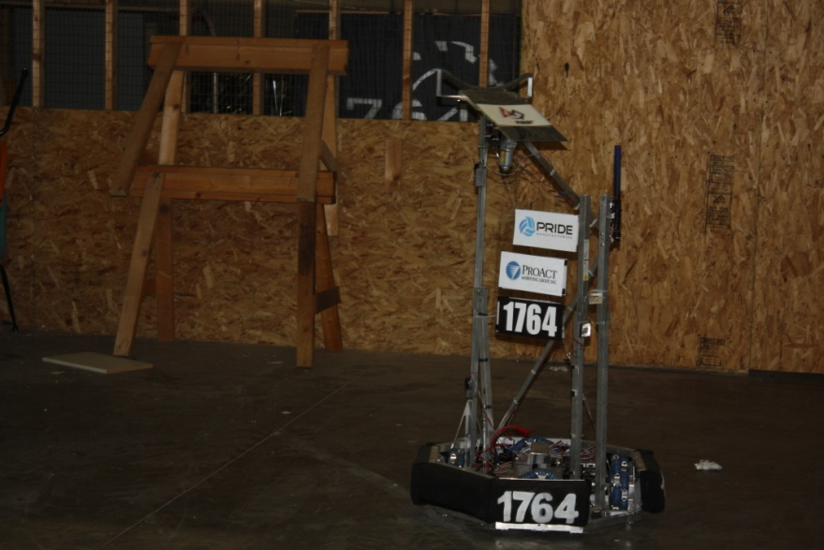
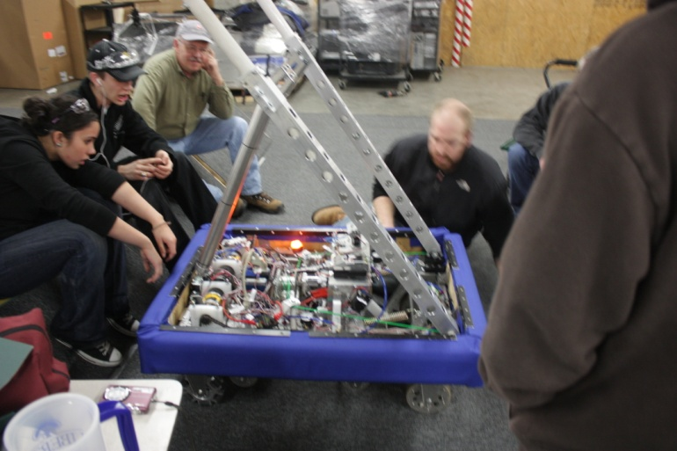
Team 1764 is part of the FIRST Robotics Competition
Liberty Robotics was founded in 2005 and has participated consecutively since that time.

Slide 4
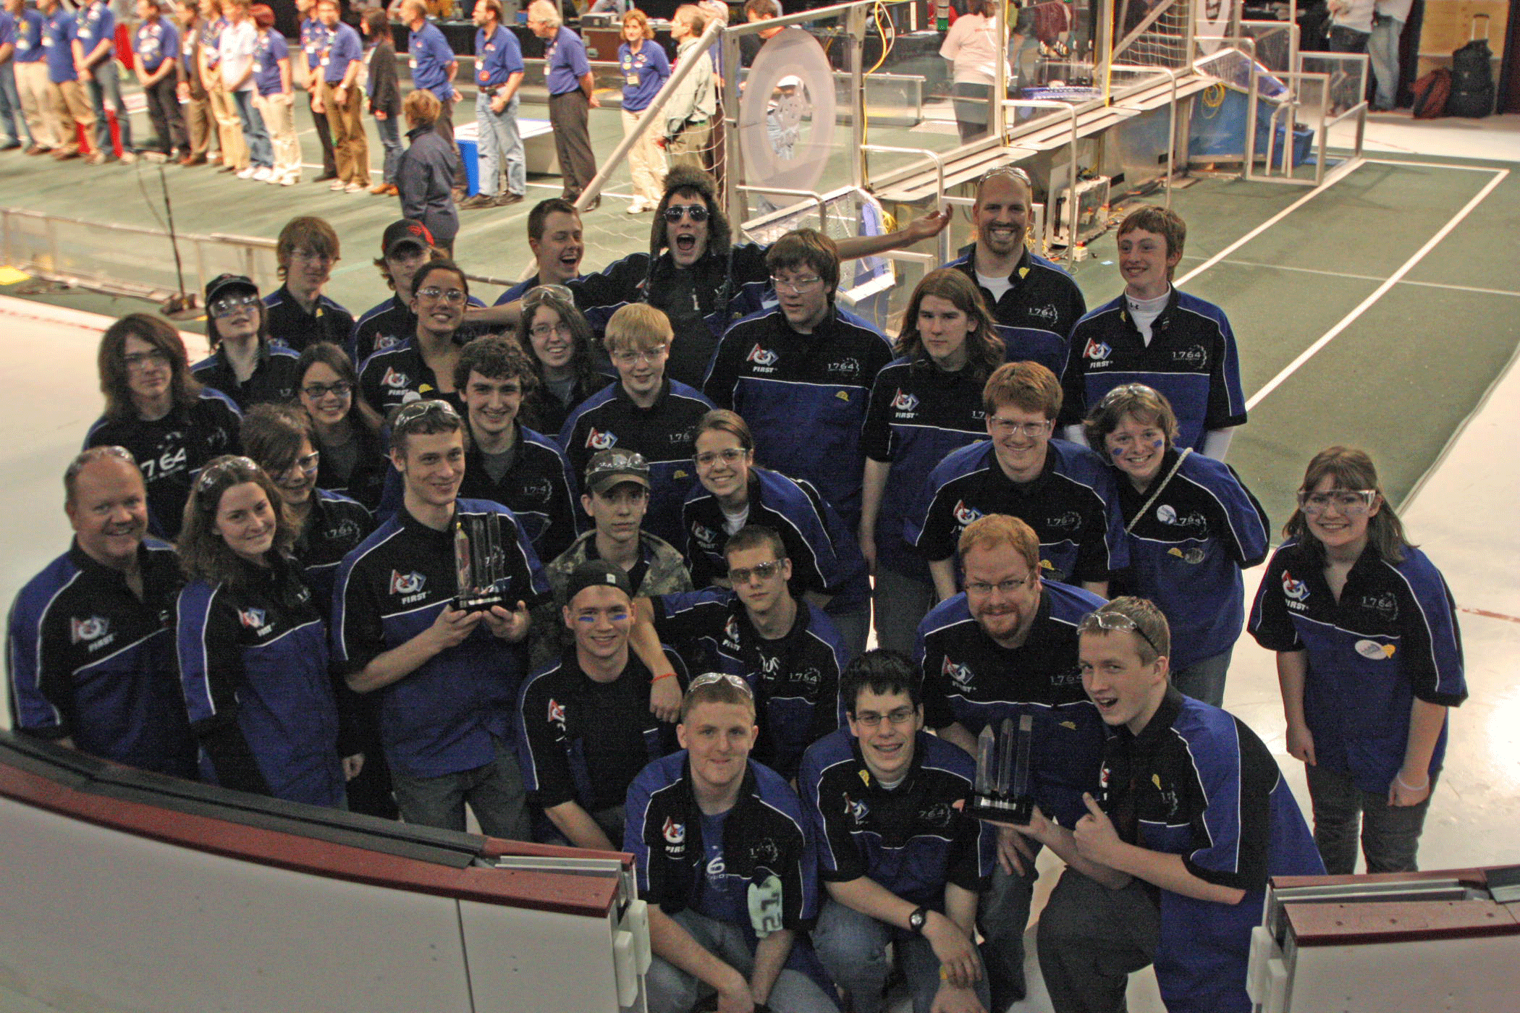
Awards
Motorola Quality Award
Safety Award
Gracious Professionalism Award
Rockwell Automation Innovation Award
CAD Finalist
Judges’ Award
Engineering Inspiration Award

Slide 5
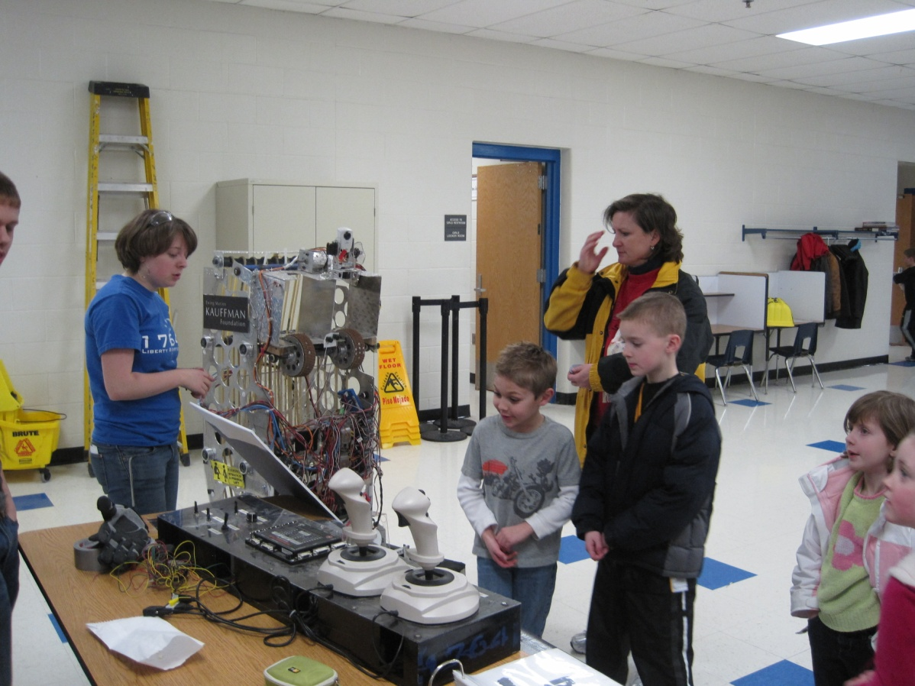

What We Do for Students
Summer Project Lead The Way camps
Providing guidance to students in STEM studies
Mentoring Lego League teams
100% of students graduate and go on to College, Military, or Vocational Studies

Slide 6
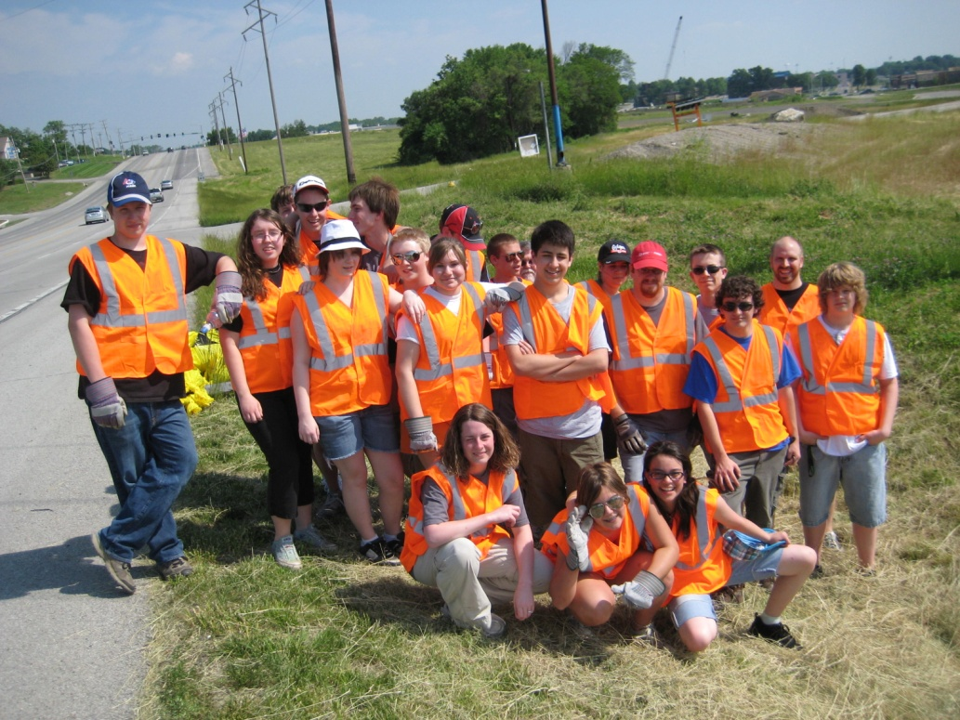
Community Service
Adopt-A-Highway
Rebuilding Together Liberty
Gracious Professionalism and Coopertition

Slide 7
Massive Mini
A workshop we host
Helps teams learn about safety, programming materials, and the implementation of different technologies
Allows other teams to practice and gain skill sets

Slide 8
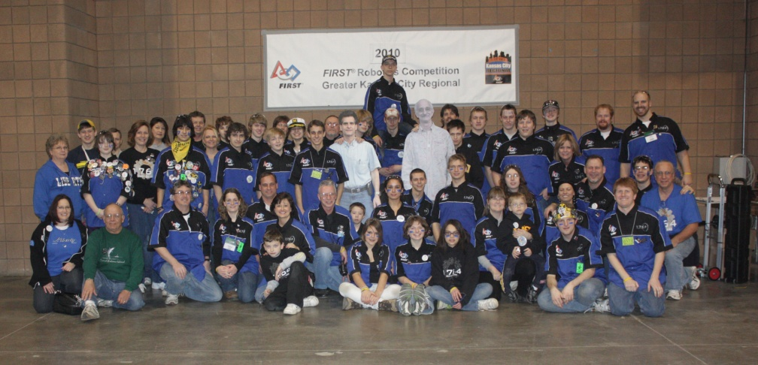
Our Goals
We plan to attend regional competitions and the World Championships held in St. Louis, Missouri
The team will attempt to take more than 45 students from two high schools
The team fundraises to get all students to the competitions

Slide 9
Budget Breakdown
We will have at least $10,000 less than we have had in years past
With the splitting of the school district, the team’s funding is getting cut down to only 66% of what it was previously
Costs include taking students on trips, parts for the robot, as well as transportation
With the necessity to move the shop, new tools are required to keep the program going

Slide 10
Sponsorship
We rely heavily on our sponsors who help fund us
There are several different levels of sponsors, including:
Diamond Sponsors (with a minimum of $5,000 in cumulative donations)
Platinum Sponsors (with a minimum of $3,000 in cumulative donations)
Gold Sponsors (with a minimum of $1,500 in cumulative donations)
Silver Sponsors (with a minimum of $750 in cumulative donations)
Bronze Sponsors (with a minimum of $250 in donations)
Friends (with a minimum of $25 in donations)

Slide 11
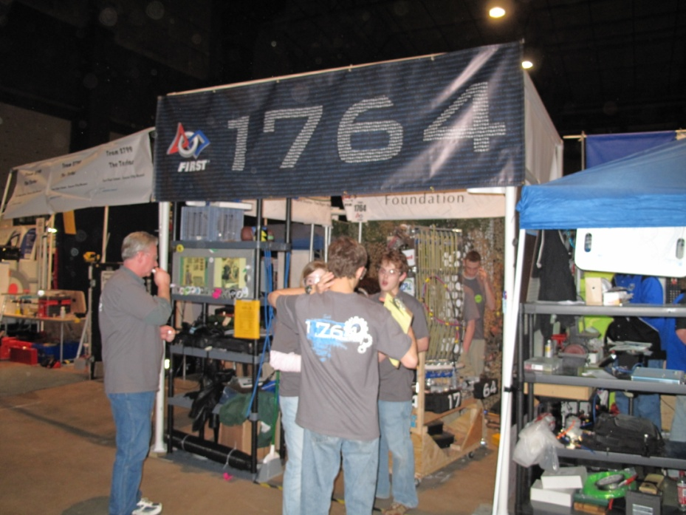
Sponsor Benefits
Tax Deductable
Advertising
Pit
Robot
Shirts
Banners
Web Site
All Projects

Slide 12
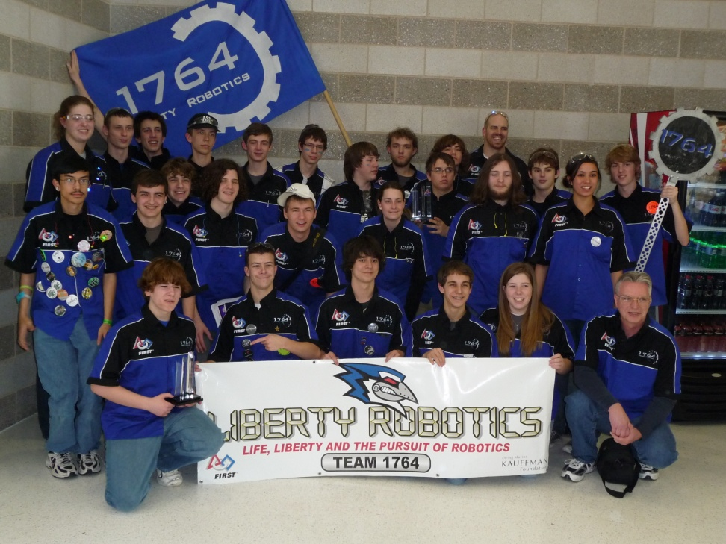
Thank You
Feel free to ask any questions and we urge you to please consider us for any contributions you are willing to make for the students and our future.

